Slide 1
Project name: Car Crash analysis By crash dummies!
Members: Shreya Udeshi, Ra Ish Andrews, Ellis Purwanto

Slide 2
Table of contents
Introduction
Data Elements
Location Data Frame
Visualization
Person Data Frame
Visualization
Time Data Fram
Visualization
Conclusion
Analysis
Analysis
Analysis

Slide 3
Introduction
The U.S. Department of Transportation, National Highway Traffic Safety Administration issued a car crash report.
Accidents in 2018 appear to relate to three variables: location, time, and driver demographic.
We will evaluate a variety of subcategories within the data set during our research, including Region (in terms of localities), Date (in terms of time), and Race (in reference to driver demographic).
SOURCE: https://www.nhtsa.gov/file-downloads?p=nhtsa/downloads/CRSS/

Slide 4
Objectives
Understand
Understand Data
Discover
Discover Patterns
Establish
Establish Relationships Between Data Elements

Slide 6
Data Elements
Location Data Frame:
CASENUM
Person Data Frame:
AGE_IM, SEX_IM, INJSEV_IM
Time Data Frame:
CASENUM, NUM_INJ, URBANICITY, MONTH, WKDY_IM, HOUR_IM

Slide 7
Location Data frame

Slide 8
Visualization

Slide 9
Analysis

Slide 10
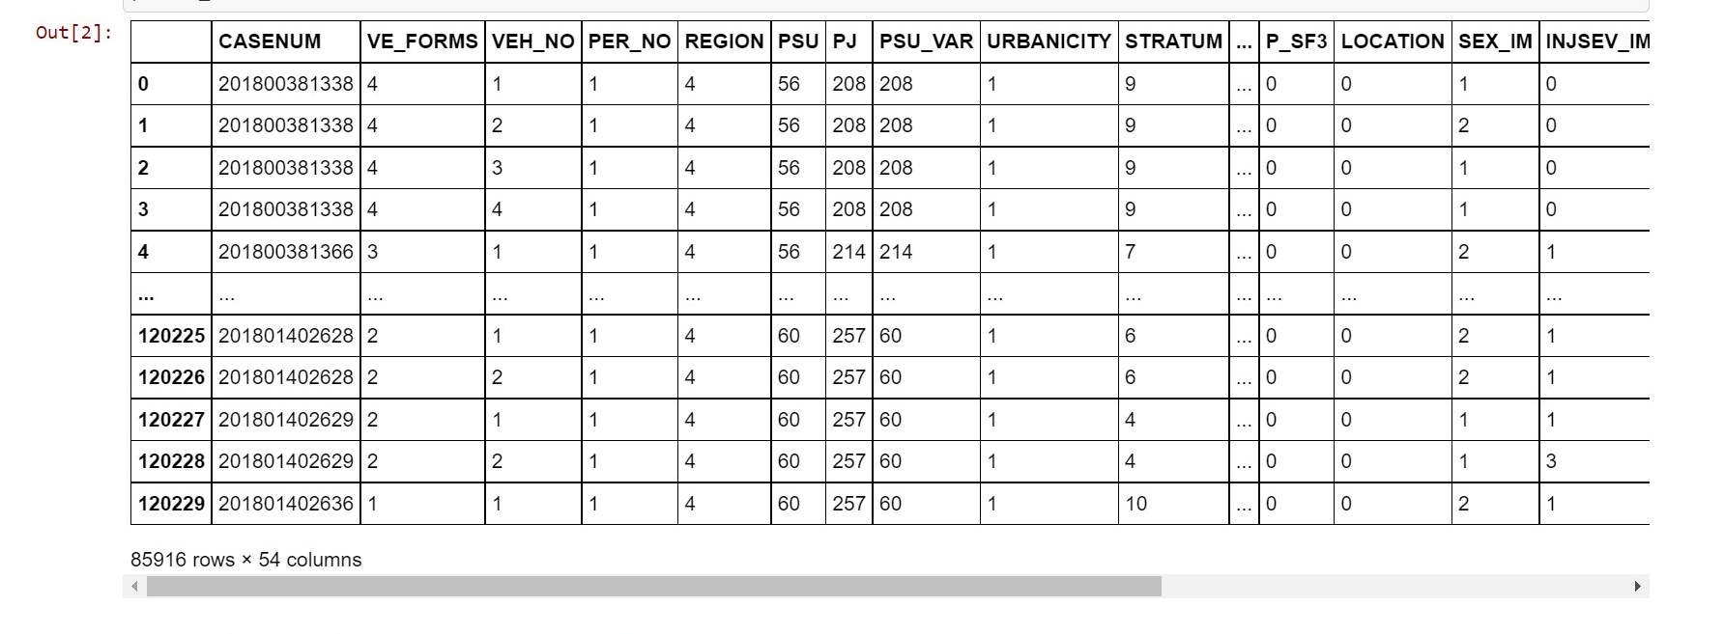
Persons DATA FRAME

Slide 11
Persons DATA FRAME
Data Analysis with Python and Pandas using Jupyter Notebook
Filtered and cleaned the data to only use driver information
Created and counted age groups using .loc and len() functions
Stacked horizontal bar plots using matplotlib library

Slide 12
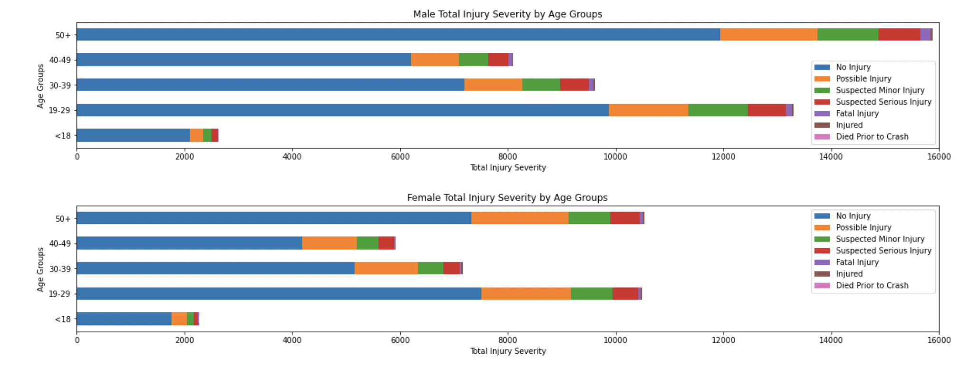
Visualization

Slide 13
Analysis
As shown in the visualizations below, it can be inferred that Males tend to drive more recklessly than Females.
Fatal Injuries tend to occur in Male Senior Drivers than any other Age Group.
Male adults aged 50 and up tend to have much more total accidents than both the <18 and 19-29 age groups combined.
Surprisingly, the <18 age group has significantly less accidents than every other age group, which could be caused by teens delaying getting a driver license or a stricter rules imposed by local authorities.
Although many accidents occur each year, over half of them, regardless of gender or age, result in No Injury.

Slide 14
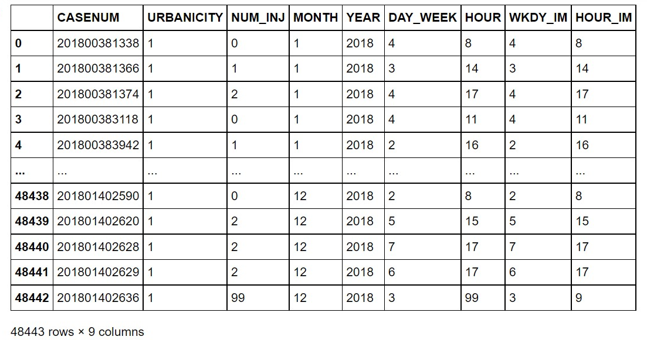
Time data frame

Slide 15
Time data frame
Utilized Python scripting, pandas and matplotlib library using Jupyter Notebook
View data and establish initial insights
Read csv file as a data frame
Filtered and cleaned the data frame
Created bar plots to analyze monthly, hourly and daily accidents
Further created bar plots to analyze monthly, hourly and daily accidents by urbanicity

Slide 16
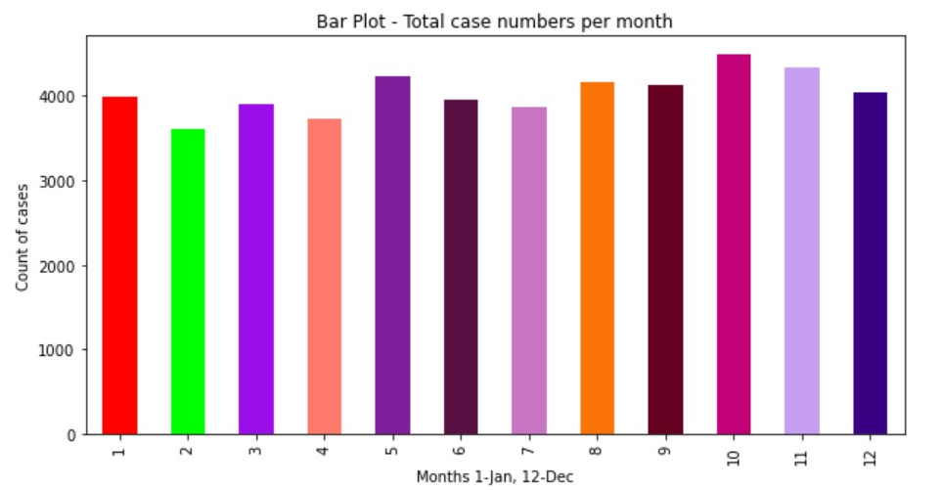
Visualization – Monthly accidents

Slide 17
Analysis
Why are most accidents taking place in the months of October, November, December?
The higher number of holiday accidents is due to a multitude of factors that occur throughout the holiday season.
Overall, there is more traffic on the roads. People are more distracted and are stress driving
Fatigued Driving, Drunk Driving
Unfamiliarity to the roads
Lastly, as it starts to get cooler it also starts to get darker sooner

Slide 18
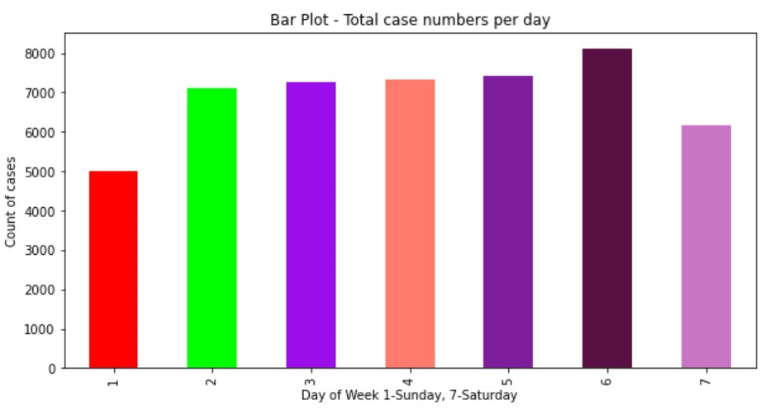
Visualization – Daily accidents

Slide 19
Analysis
Why are most accidents taking place on Friday?
As we can see from the bar graph, car crashes on weekdays are practically identical, however there are more car crashes on Friday and Saturday since people are all coming home for the weekend.
According to a study, more people are consuming alcohol on the weekends, and more people are also feeling relaxed after the work week. This leads to more drunk driving crashes, as well as auto accident injuries resulting from speeding and other forms of reckless driving.

Slide 20
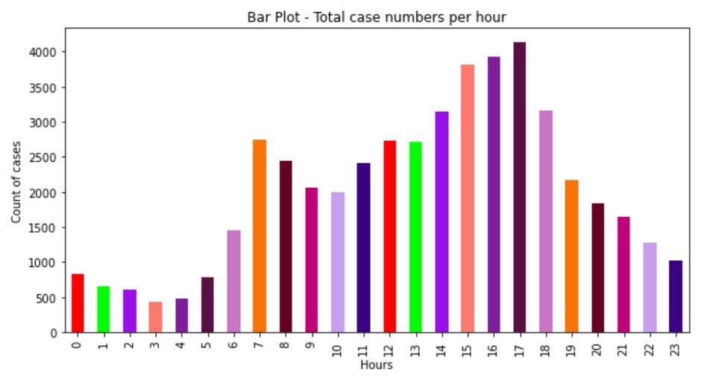
Visualization – HOURLY accidents

Slide 21
Analysis
Why are most accidents taking place in rush hours (3PM – 6PM)?
Believe it or not, most auto accident injuries and fatalities happen during rush hour on most days of the week
A number of these collisions result from people returning home after office hours, aggressive driving and tailgating

Slide 22
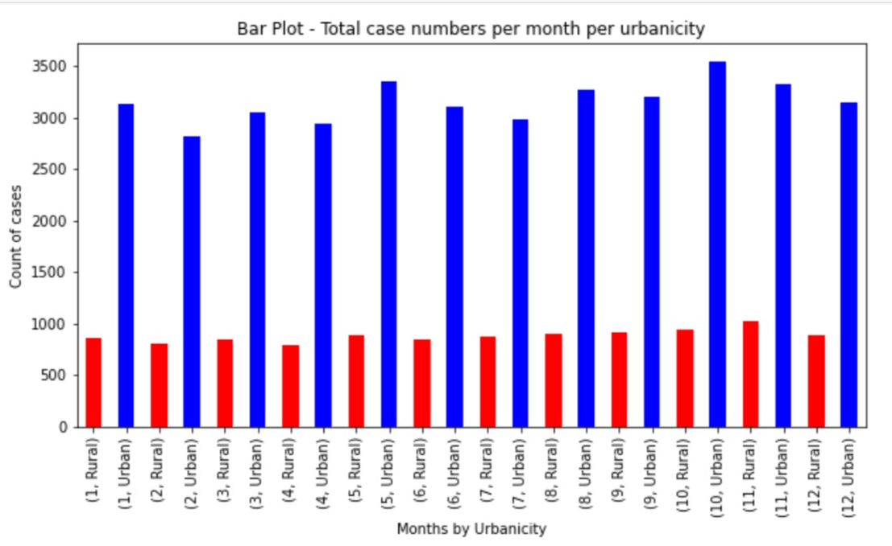
Visualization – HOURLY accidents by urbanicity

Slide 23
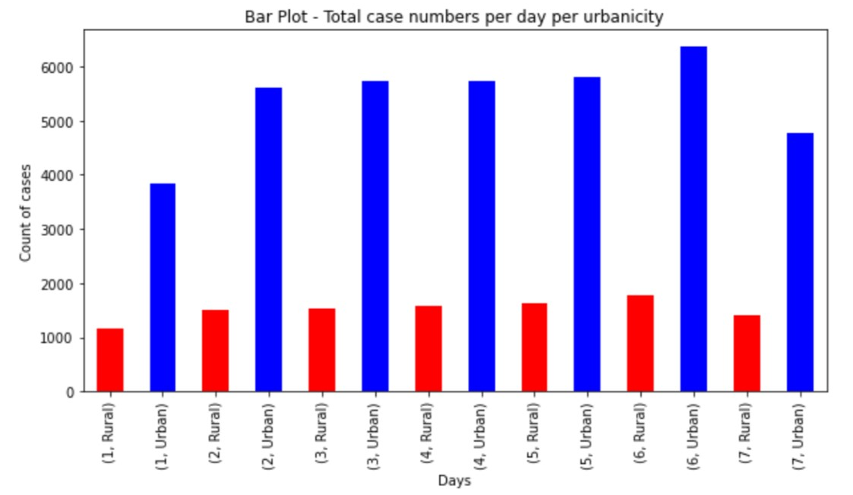
Visualization – DAILY accidents by urbanicity

Slide 24
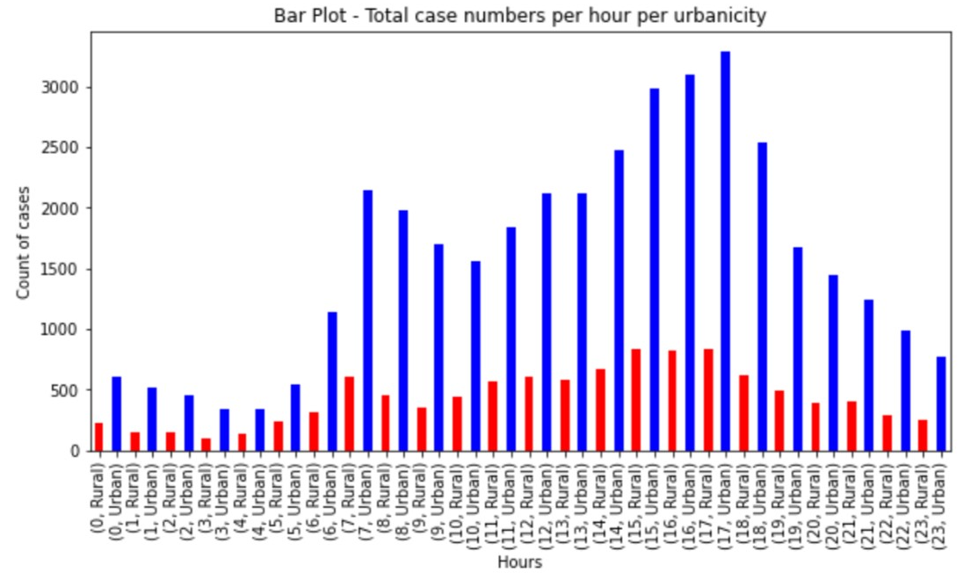
Visualization – HOURLY accidents by URBANICITY

Slide 25
Analysis
The accompanying figures clearly show that most car accidents occur in urban settings. In comparison to rural areas, urban areas have 30-40% more crashes.
Car accidents in cities are caused by several common factors:
Tailgating, dangerous driving (including speeding and incorrect lane changes), and road rage are all caused by large traffic volumes on multi-lane highways
One-way streets and a limited number of U-turns
Potholes can cause drivers to lose control of their vehicles or damage the tires on their automobiles.
It is exceedingly dangerous for drivers to run red lights.
Notes:
One observation for rural areas: the number of cases is identical monthly and daily.. While it differs slightly hourly

Slide 26
Conclusion

Slide 27
Thank you!

